Slide 1
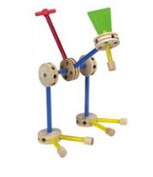
Morning Slides Boot Camp for Digital Systems Education Circuit Simulation & RTL generation
Jim Brakefield jim.brakefield@ieee.org
IEEE Computer Society
Notes:
Tinker toy construction embodies the generation/design of objects from simple uniform components

Slide 2
Preliminaries
Classroom provided by St. Mary’s University
Funding provided by a grant from the IEEE Computer Society as part of their Emerging Technologies program
I’m Jim Brakefield, jim.brakefield@ieee.org
Full set of today’s files (20 MB): https://github.com/jimbrake/FPGA_Boot_Camp
Introduction to FPGA video: https://www.youtube.com/watch?v=EVy4KEj9kZg
Lunch today at St. Mary’s cafeteria (line up at counter and the IEEE grant will pick up the tab)

Slide 3
This Morning’s Agenda
View Youtube video
Review of digital logic & binary
Download Digital simulator
Exercise simulator (many example schematics)
Add Boolean Board configuration files
Install configuration files
Create new (your) schematic with IO pins
Save VHDL or Verilog RTL of schematic
Inspect RTL

Slide 4
Not quite free
Using the grant money to buy an FPGA board for each student (and lunch), the idea being that way each student can spend more time on the board.
In return for the “free” FPGA board, you e-mail a progress report periodically to jim.brakefield@ieee.org
Part of the grant is to determine the viability of this approach to FPGA education, hence need feedback.

Slide 5
My view of binary
Zero and ones: One names a single such signal or a group of such signals (subscripted by bit number)
A binary number is a polynomial:
A[n-1]x^{n-1} + A[n-2]x^{n-2} + … A[1]x¹ + A[0]x⁰
Where X = 2, and A[n] are 0 or 1 bits from the number. If A[n-1] is 0/-1 then it is 2’s complement and negative if A[n-1] is -1.
It is typical for the bit numbers to run from N-1 to 0 where N is the number of bits.
Adding or subtracting 2’s complement wraps around in a circle where the most positive and most negative numbers are adjacent (any carry or borrow beyond x^{n-1} is discarded).
Windows calculator has binary features: https://www.youtube.com/watch?v=PK5WQqN3_44
10/14/2022
5
Notes:
For me this approach has the cleanest understanding of signed 2’s complement arithmetic. The youtube video covers all the calculator features including radix (binary, hex, decimal) and the binary operations (AND OR, XOR, shifts and rotate).

Slide 6
Interactive digital simulation
Schematic editor and simulator
Provides an intermediate step before RTL (Register Transfer Logic) and full FPGA tools.
Requires nothing beyond a PC.
Requires Java
Totally interactive
Generates VHDL or Verilog RTL files
Generates constraint file for vivado (xilinx FPGA tool)
Notes:
The two main RTLs are verilog and VHDL. Most recent verilog is called System Verilog. ASIC people prefer verilog. DOD and Europe like VHDL. There are linting tools that can check your code including adherence to code standards.

Slide 7
“Digital” logic simulator
Web site: https://github.com/hneemann/Digital/
Authored by: Helmut.Neemann@mosbach.dhbw.de
Open source, other simulators available
Modified to support the Boolean board
BASYS3.config renamed to Boolbd.config
BASYS3_IO.dig renamed to Boolbd.dig
And pin assignments updated
And PMOD pins moved to Boolbd_pmod.dig
In the subdirectory examples/hdl

Slide 8
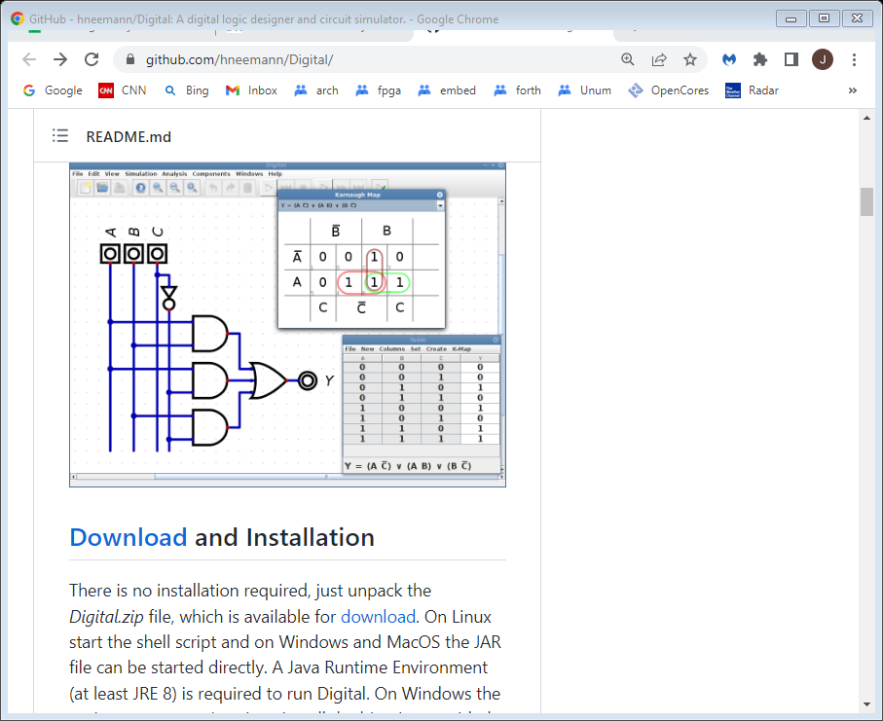
Digital web page https://github.com/hneemann/Digital/
Is 12MB zip file
22MB unzipped
Must have Java installed
Notes:
Is 12MB zip file 22MB unzipped. Approximately monthly maintance updates to the software.

Slide 9
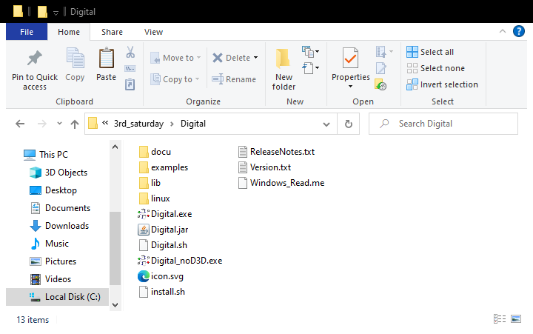
Unzipped Digital directory Double click on either *.exe

Slide 10
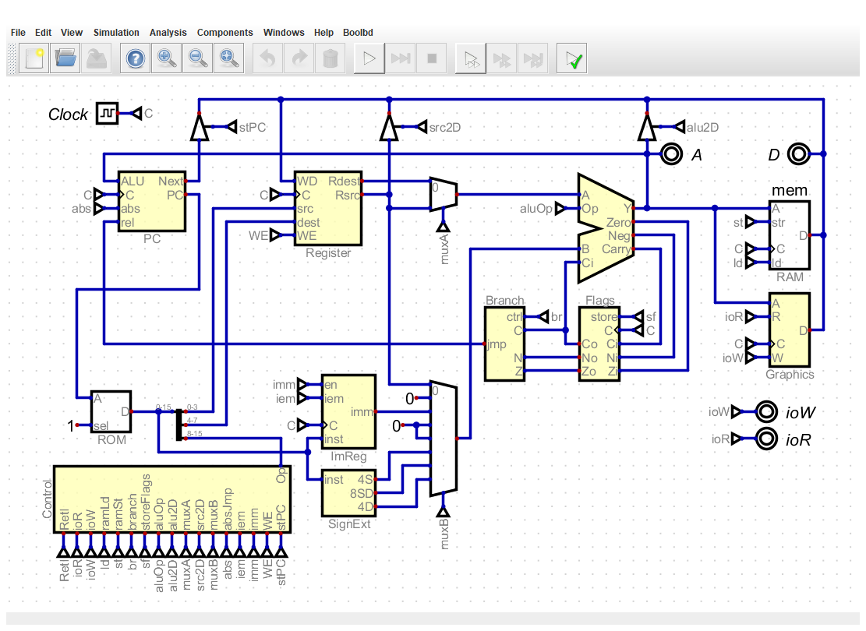
Initial Digital screen will change to last schematic you viewed
Note: Clock references, bus width indicators.
Small triangles are named signal references, e.g. implied connections.
Tri-states not used within FPGAs.
Right click on an icon to see/set data width.
Notes:
This in the file Digital/examples/processor/Processor.dig. Digital remembers the last schematic somewhere on your PC.
Note: Clock references and bus width indicators. Tri-states which are not used in FPGAs. Right click on an icon to see/set data width.
From examples/processor/Processor.dig. https://github.com/hneemann/Assembler has the processor assembler.

Slide 11
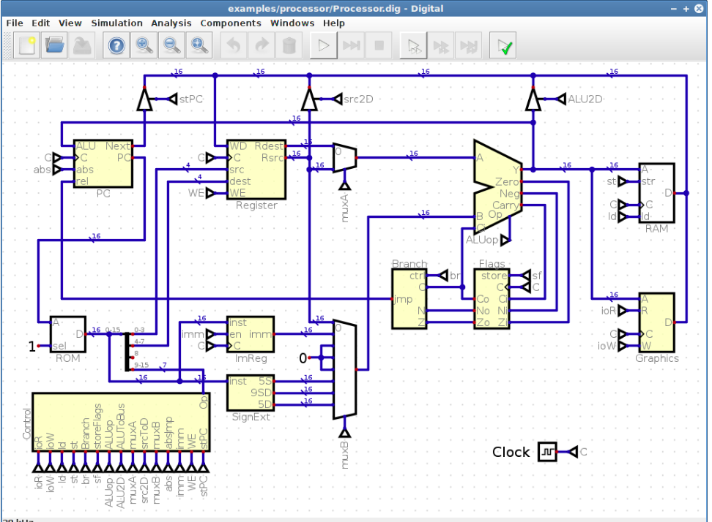
High res github.com/hneemann/Digital
Notes:
Note: Clock references, bus width indicators. Tri-states not used within FPGAs. Right click on an icon to see/set data width.
From examples/processor/Processor.dig. https://github.com/hneemann/Assembler has the assembler.

Slide 12
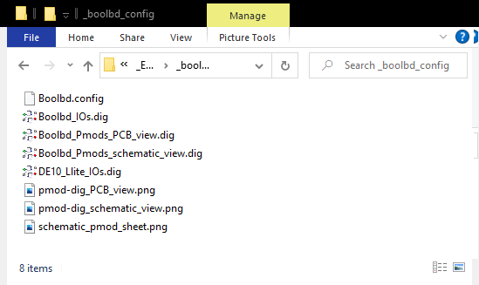
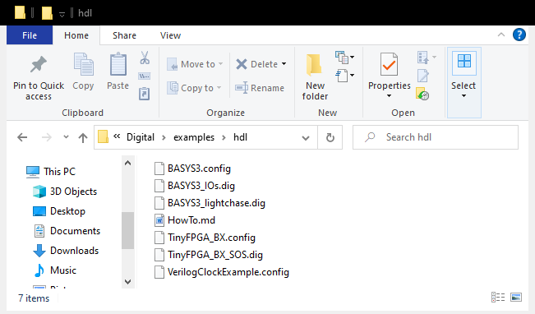
Configure Digital for Boolean Board
Copy
To:
Notes:
Boolbd.config and Boolbd_Ios.dig are in the _boolbd_config directory

Slide 13
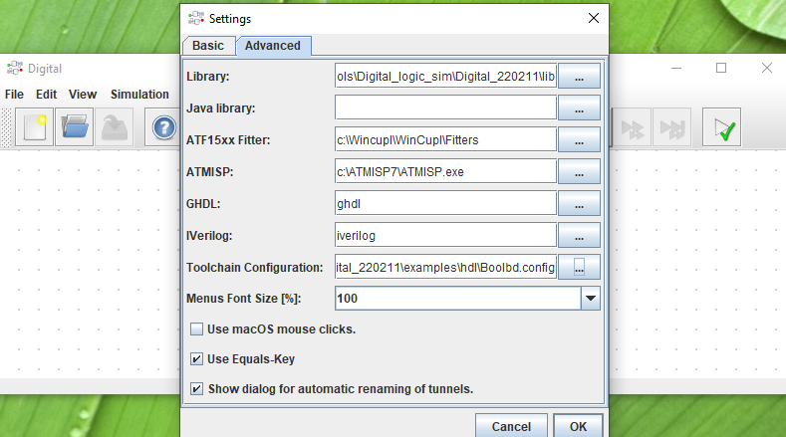
Configure for Boolean Board
Go to Edit Settings Advanced
Specify Toolchain Configuration file
From examples/hdl select Booleanbd.config
Notes:
To un-configure erase the “Toolchain Configuration” entry. *.config file has the new menu item name (Boolbd) on line 2(in case of a rename). . Support for DE10-Lite board in the works.

Slide 14
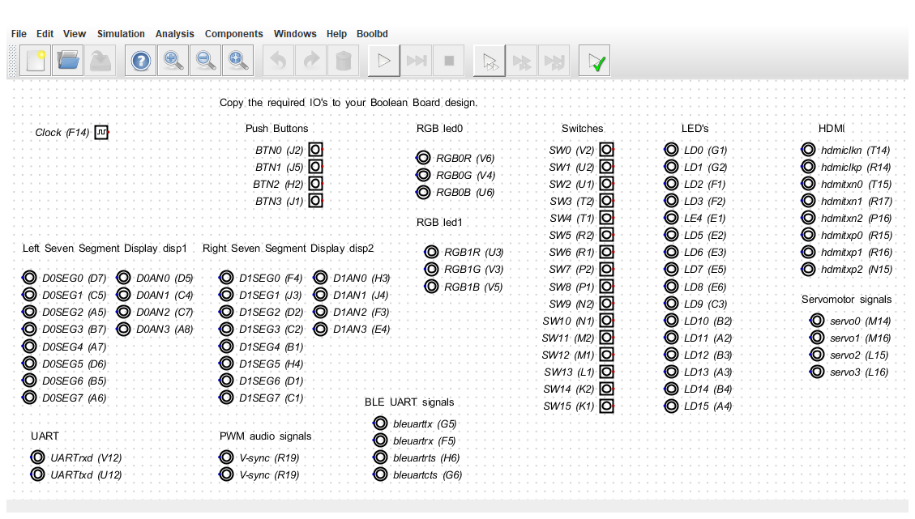
Digital with additional menu item always starts with last schematic, here the Boolean board IO pins
Notes:
After opening Boolbd_Ios.dig This is write protected, save to new file to edit. A starting point for you FPGA board design: prune and add circuits!

Slide 15
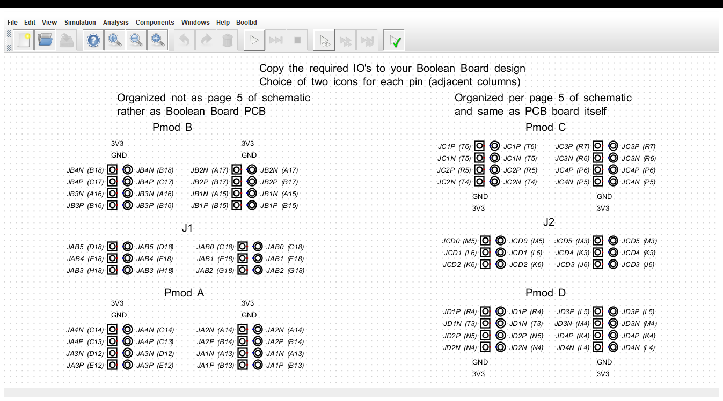
Boolean Board Pmod IOs Boolbd_Pmods_PCB_view.dig
https://github.com/jimbrake/FPGA_Boot_Camp
10/14/2022
15
Notes:
PCB view is as you look at the board. Schematic view is as you look at the schematic. RE adjacent columns: use the square icon for inputs and the round icon for outputs.

Slide 16
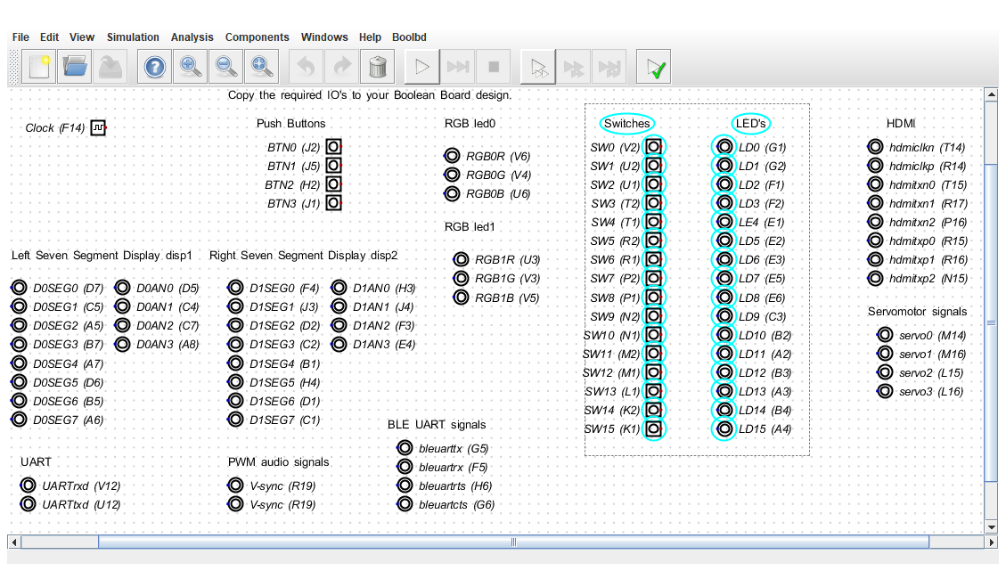
Drawing a rectangle for cut & paste or delete point & drag with mouse

Slide 17
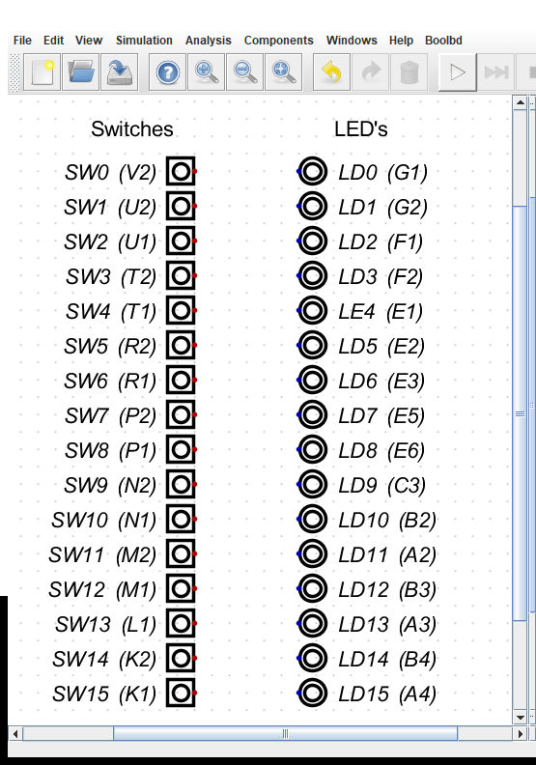
Insert into “new” and “save as”

Slide 18
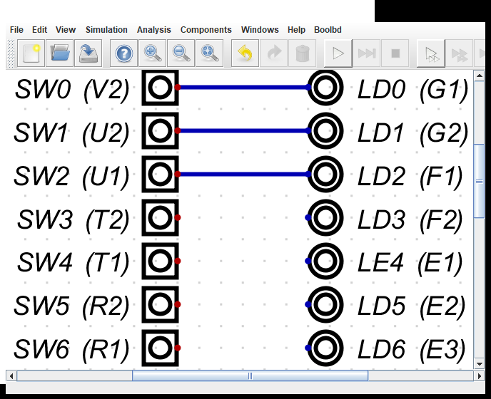
Connect switches to LEDs
Point at a red dot,
release,
move to LED dot
and release
Add logic gates
from Components
Add clock from IO
Add D flip-flop
from Flip-Flops
Notes:
There is a choice of using Digital icons for simulation only or using Boolean board icons for both simulation and RTL generation.

Slide 19
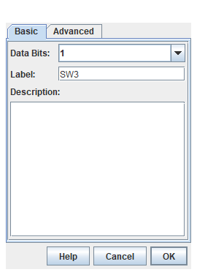
Inspecting switch or LED
Right click
Basic menu
Number of data bits &
Label for switch

Slide 20
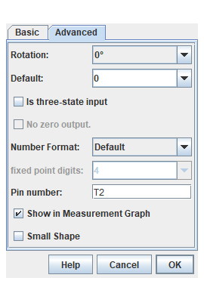
Inspecting switch or LED
Advanced menu
Rotation
Pin number
Is FPGA chip pin #
Can be found on
Boolean Board schematic
Or in the Boolean Board constraint file
Notes:
Xilinx/AMD constraint files have .xdc suffix

Slide 21
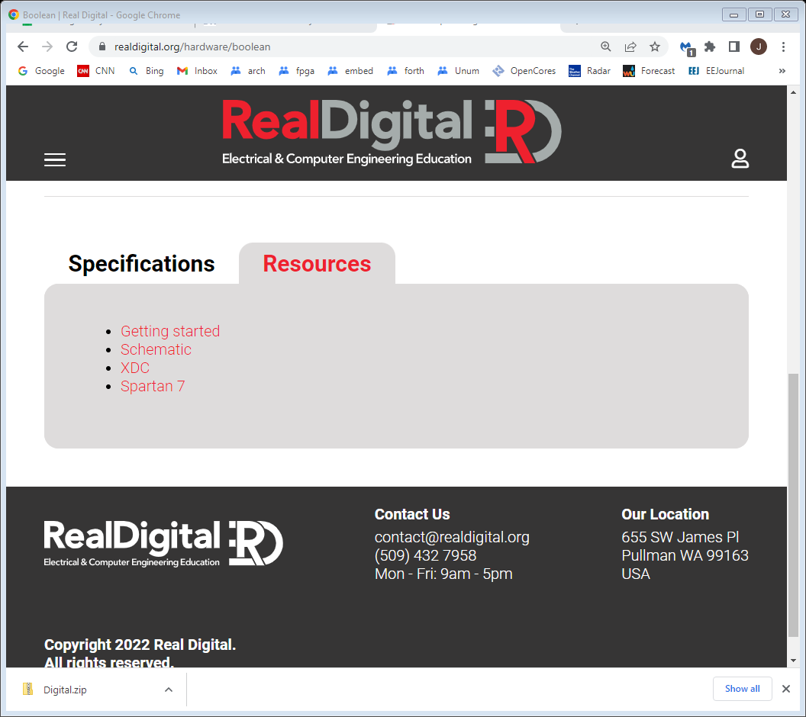
Boolean Board Resources https://www.realdigital.org/hardware/boolean
Schematic is PDF file of board
XDC for downloading constraint text file
Getting started goes to reference manual web page
Notes:
Spartan 7 goes to technical documentation for Spartan 7 FPGA family

Slide 22
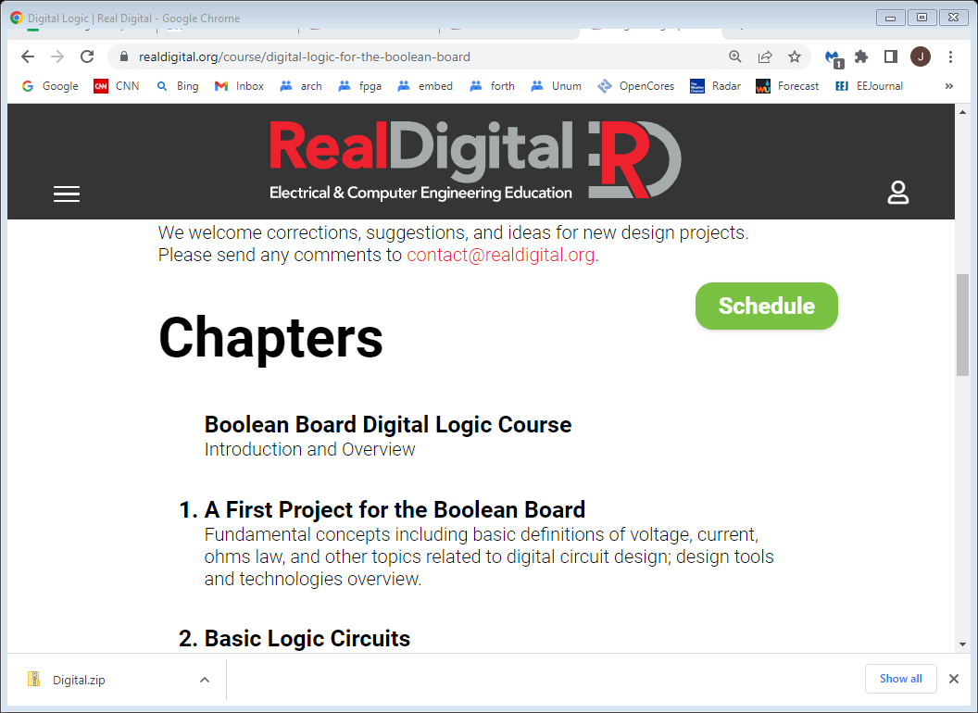
Basic Digital tutorials https://www.realdigital.org/course/digital-logic-for-the-boolean-board
Notes:
Web page recently updated

Slide 23
Wikipedia basic logic circuits
Full adder https://en.wikipedia.org/wiki/Adder_(electronics)
Multiplexer https://en.wikipedia.org/wiki/Multiplexer
ALU https://en.wikipedia.org/wiki/Arithmetic_logic_unit
Has easy to understand VHDL source code
Barrel shifter https://en.wikipedia.org/wiki/Barrel_shifter
Wallace tree multiplier https://en.wikipedia.org/wiki/Wallace_tree
Synchronous binary up counter
In schematic form: change a Dff if all preceding Dff are all 1
In RTL: “if enable AND rising-clock then count <= count+1”
Notes:
Didn’t find good examples of up counter?

Slide 24
What do FPGA tools do?
Much goes on behind the scenes
Circuit is optimized (logic simplification)
unused stuff is pruned, if no outputs then all pruned
Circuit is mapped into FPGA primitives
Circuit wired up with FPGA routing resources
Bit file generated that configures the chip
Error checking especially missing semicolons
Reports on timing, resources used, error messages
Elaborated Design viewer shows vivado version of your schematic
Notes:
Schematic viewer shows FPGA chip floor plan, the actual layout of LUTs, DFF, DSP units and Block RAMs.
Elaborated Design viewer shows vivado version of your schematic

Slide 25
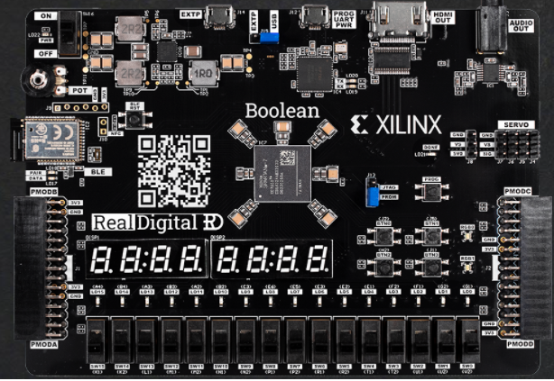
Boolean board $69/$79
Notes:
Uses AMD/xilinx tools(vivado). The staggered IO holes is deliberate, will hold and connect headers without soldering. HDMI video out. Available with or without Bluetooth LE.

Slide 26
Boolean Board background
RealDigital.org
Educational mission
Very well done courseware, uses hyper links
Have added additional boards to their web site
Board uses AMD/xilinx Spartan-7 FPGA
Full part number: XC7S50-CSGA324
50K logic cells (33K 6-LUTs)
2.8M bits of block RAM (300K bytes)
One of the least expensive FPGA boards with full user IO, also servo headers & potentiometer
Notes:
Working on Digital supporting the DE10-Lite board.

Slide 27
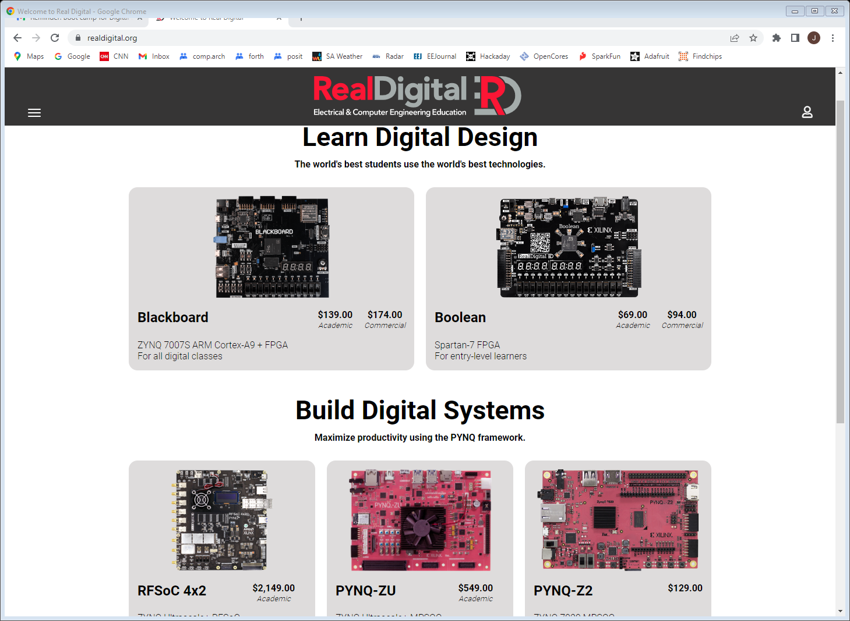
RealDigital.org
Notes:
IMHO For more advanced work, especially using ARM cores PYNQ-Z2 a better choice over Blackboard: Has Xilinx PYNQ tool set. Serial port used for IO when ARM core present. The three boards on bottom added to original two boards. Shows a dedication to advanced capabilities.

Slide 28
Downloading vivado now has an ITAR notice
https://www.xilinx.com/support/download.html
https://www.xilinx.com/support/installer/installer-info-general.html
Use the web installer (212MB) and only install for Spartan-7 devices. Full install is a 74GB tar.gz file!!
Will still take time (~2hrs) and 44GB download!
Takes 71GB of disk space!! ☹
Follow RealDigital Boolean Board instructions at https://www.realdigital.org/doc/1fd3322461ac4bcc1fcd6bcc6c5907ec
Can add additional FPGA devices later
Hundreds of video tutorials (use help button)
Notes:
Took 3 hours total at 100Mb/sec download speed. I did not turn off anti-virus protection.

Slide 29
Educational programs
Intel/Altera academy Quartus: RTL & Schematic
AMD/Xilinx university program ISE & Vivado RTL tools
Courseware for Real Digital Boolean board RTL
https://www.realdigital.org/course/digital-logic-for-the-boolean-board
https://www.tina.com/ (Schematic based, not free)
Support for the Digilent Basys 3 and the Terasic DE10-Lite FPGA boards
https://www.tina.com/blog/programming-fpga-boards-with-tina-using-schematic-design-entry/
Digital logic simulator (Schematic based)
Support for the Digilent Basys 3 and the TinyFPGA-BX boards
https://github.com/hneemann/Digital/
Notes:
RTL: Register transfer language, usually VHDL or Verilog. Quartus and Vivado are mainstream tools with free education variants (have reduced FPGA family support). Xilinx ISE not recommended for new users.

Slide 30
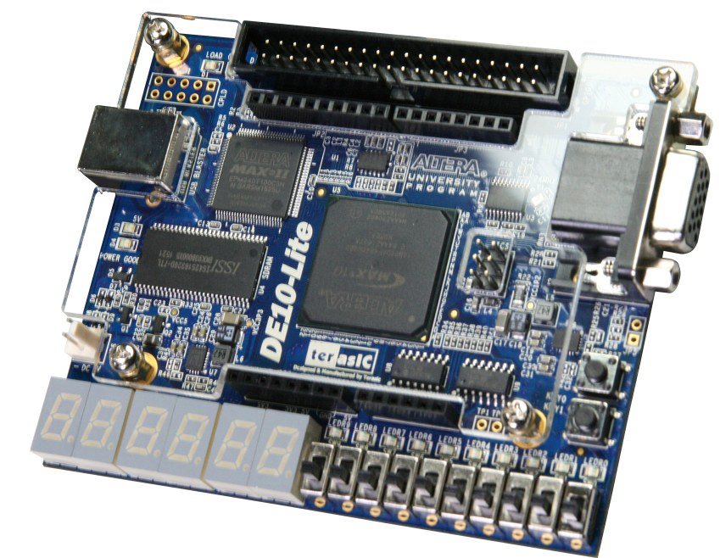
Intel/Altera academic program
https://www.intel.com/content/www/us/en/developer/topic-technology/fpga-academic/overview.html
https://www.intel.com/content/www/us/en/developer/topic-technology/fpga-academic/materials.html
https://fpgacademy.org/tools.html
DE10-Lite academic price $77
Notes:
Only two push buttons. Least expensive Altera board with “full” user IO. Altera tools support schematic capture. Quartus constraint files differ from vivado constraint files.

Slide 31
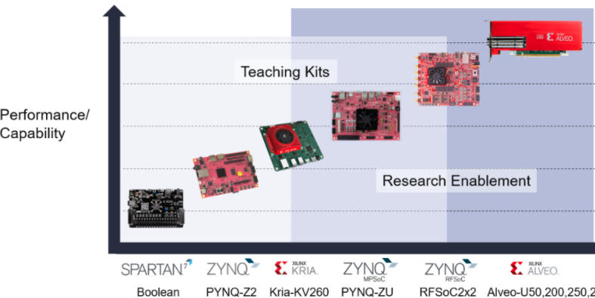
Xilinx university program
https://www.xilinx.com/support/university.html
https://www.xilinx.com/support/university/xup-boards.html
$69 $123 $200
$549
$2149
Notes:
Boolean Board “endorsement” by Xilinx. Kria-KV260 has state-of-the-art FPGA, heavily backordered.

Slide 32
FPGA Application Areas
Communications
DSP
Software-defined radio
Aerospace and defense systems
ASIC prototyping
Medical imaging
Computer vision
Speech recognition
Cryptography
Bioinformatics
Computer hardware emulation
Data Center: AI, NN, big data
Advantages:
Outstanding Job market
Disadvantages:
Tough learning curve

Slide 33
The chip manufacturers
Xilinx (now AMD): www.xilinx.com
Originated FPGAs with help from AMD
Altera (now Intel): www.altera.com
Originally CPLDs, #2 in FPGAs.
Microsemi (Now Microchip, was originally Actel): www.microsemi.com/product-directory/1636-fpga-soc
SRAM & flash based
Lattice Semiconductor: www.latticesemi.com
Offer tiny FPGA chips
Quicklogic: www.quicklogic.com
ARM + ~2K LUTs
Gowinsemi: https://www.gowinsemi.com/en/

Slide 34
FPGA References
Twelve youtube videos on specific FPGA features (uses verilog RTL): https://www.youtube.com/playlist?list=PLEBQazB0HUyT1WmMONxRZn9NmQ_9CIKhb
Three Ages of FPGAs: A Retrospective…, Steve Trimberger, Proc. IEEE v103#3p318, 2015
www.cpe.virginia.edu/grads/pdfs/January%202016/VLSI.pdf
https://www.youtube.com/watch?v=4ntXSyOhlBY
Xilinx Part Family History, John Lazzaro,
www-inst.eecs.berkeley.edu/~cs294-59/fa10/resources/Xilinx-history/Xilinx-history.html
Altera History, corporate, http://www.fundinguniverse.com/company-histories/altera-corporation-history/
www.altera.com/about/company/history.html
Low cost FPGA boards
https://www.joelw.id.au/FPGA/CheapFPGADevelopmentBoards
Open source IP https://opencores.org/projects
Notes:
Many open source projects using FPGAs on Github.

Slide 35
Built-in IO Done Just Right
10+ slide switches or DIP switches
6+ push buttons
10+ LEDs, two tri-color (RGB)
7-segment LEDs (four to eight digits)
VGA or HDMI connector
Expansion IOs
Arduino, Pi, PMOD, Grove, DIP pattern…

Slide 36
Nice to have built-in IO
Potentiometer or incremental encoder
Servo connector(s)
Navigation switch or rhombic push button pattern
Pmod connector(s)
Grove connector(s)
Built-in microprocessor (usually ARM)
SRAM or DRAM (for microprocessor support)
SD socket (for microprocessor OS)
Notes:
The servo connectors make for a robotics capable board. Usage model for potentiometer is showing the voltage on the 7-segment display. Those ready to do soft core or built in processor probably don’t need switches, LEDs and 7-segment displays; use serial terminal instead.

Slide 37
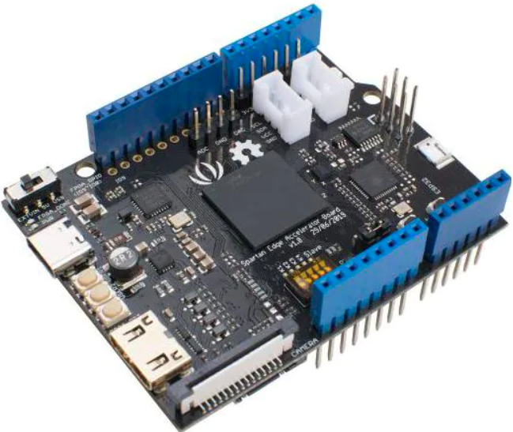
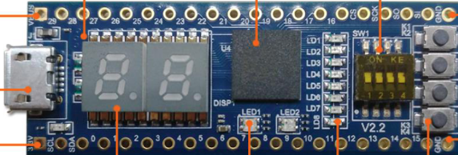
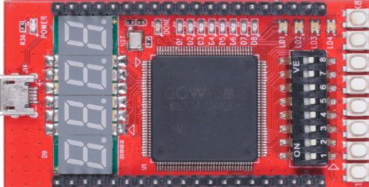
Under $40 & some built-in IO
StepFPGA MAX10 dev board $39
Seeedstudio Spartan-7 Edge
Accelerator board $40
Seeedstudio
Gowin RUNBER $30
Notes:
Four digit 7-segment display with 5 push buttons Arduino shield for Edge Accelerator $9 (uses I2C).

Slide 38
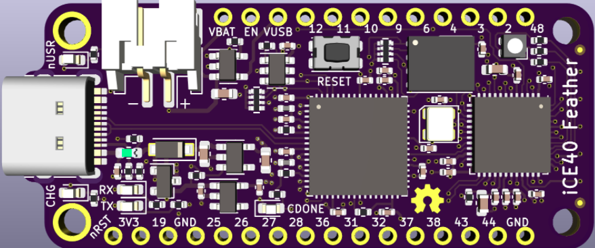
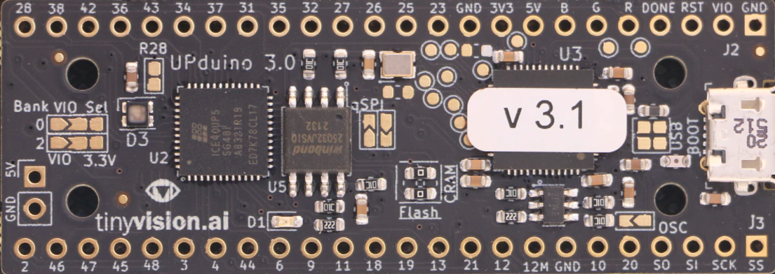
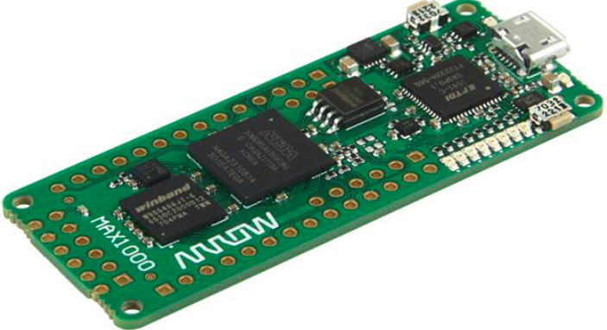
Very little built-in IO $25-30
iCE40
Feather
Has battery
support
Trenz MAX-1000
Has 8MB ram
UPDuino v3.1

Slide 39
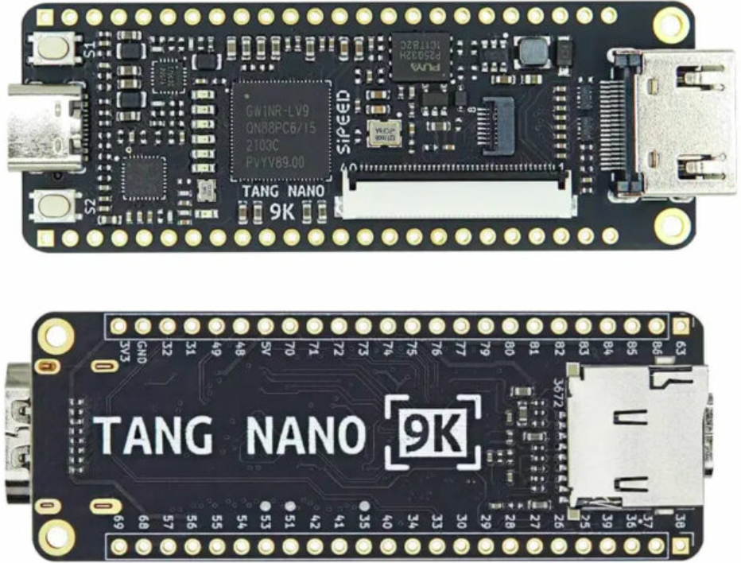
Very little built-in IO $15
Notes:
Uses Gowin GW1NR-9 FPGA: ARM Cortex M3, 8K LUTs, 2 push buttons, 6 LEDs, HDMI connector, SD slot, DRAM, LCD connector

Slide 40
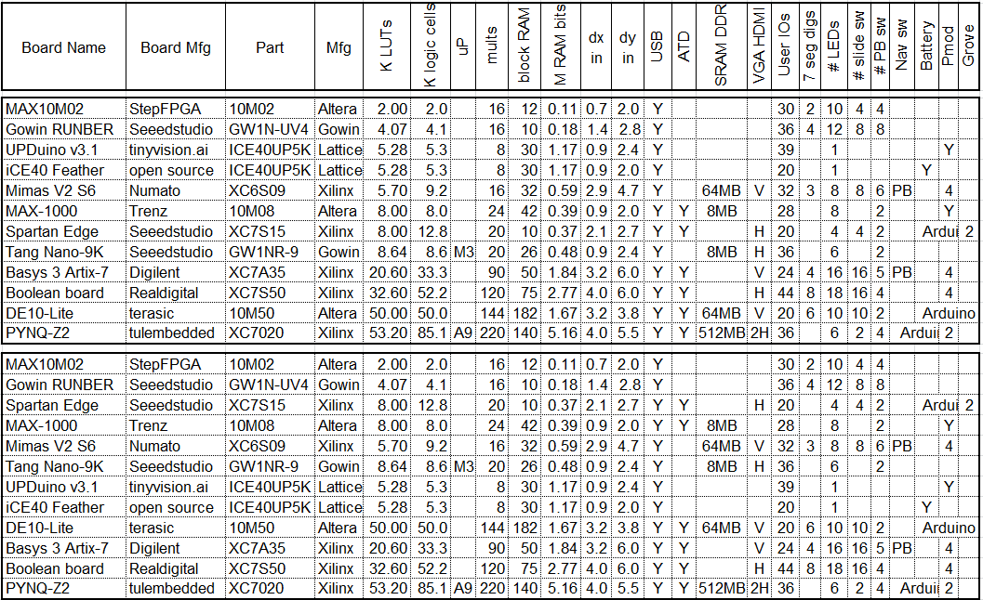
FPGA board rankings
Top version sorted by LUT count, bottom version by block RAM bit count
This listing is only a sample of the hundreds of boards available.
10/14/2022
40

Slide 41
In conclusion
It is thought that ownership of an FPGA board will lead to greater usage and knowledge. As opposed to shared laboratory equipment.
Oriented towards a beginner’s board at low cost. Lots of switches, LEDs etc. eliminate need for discrete components and their fragile wiring.
These slides and other files at: https://github.com/jimbrake/FPGA_Boot_Camp
Future classes TBD
Notes:
Files at https://github.com/jimbrake/FPGA_Boot_Camp have a date code suffix and are updated frequently. Currently several universities issue an FPGA board to each student for a one semester course.

